Slide 1
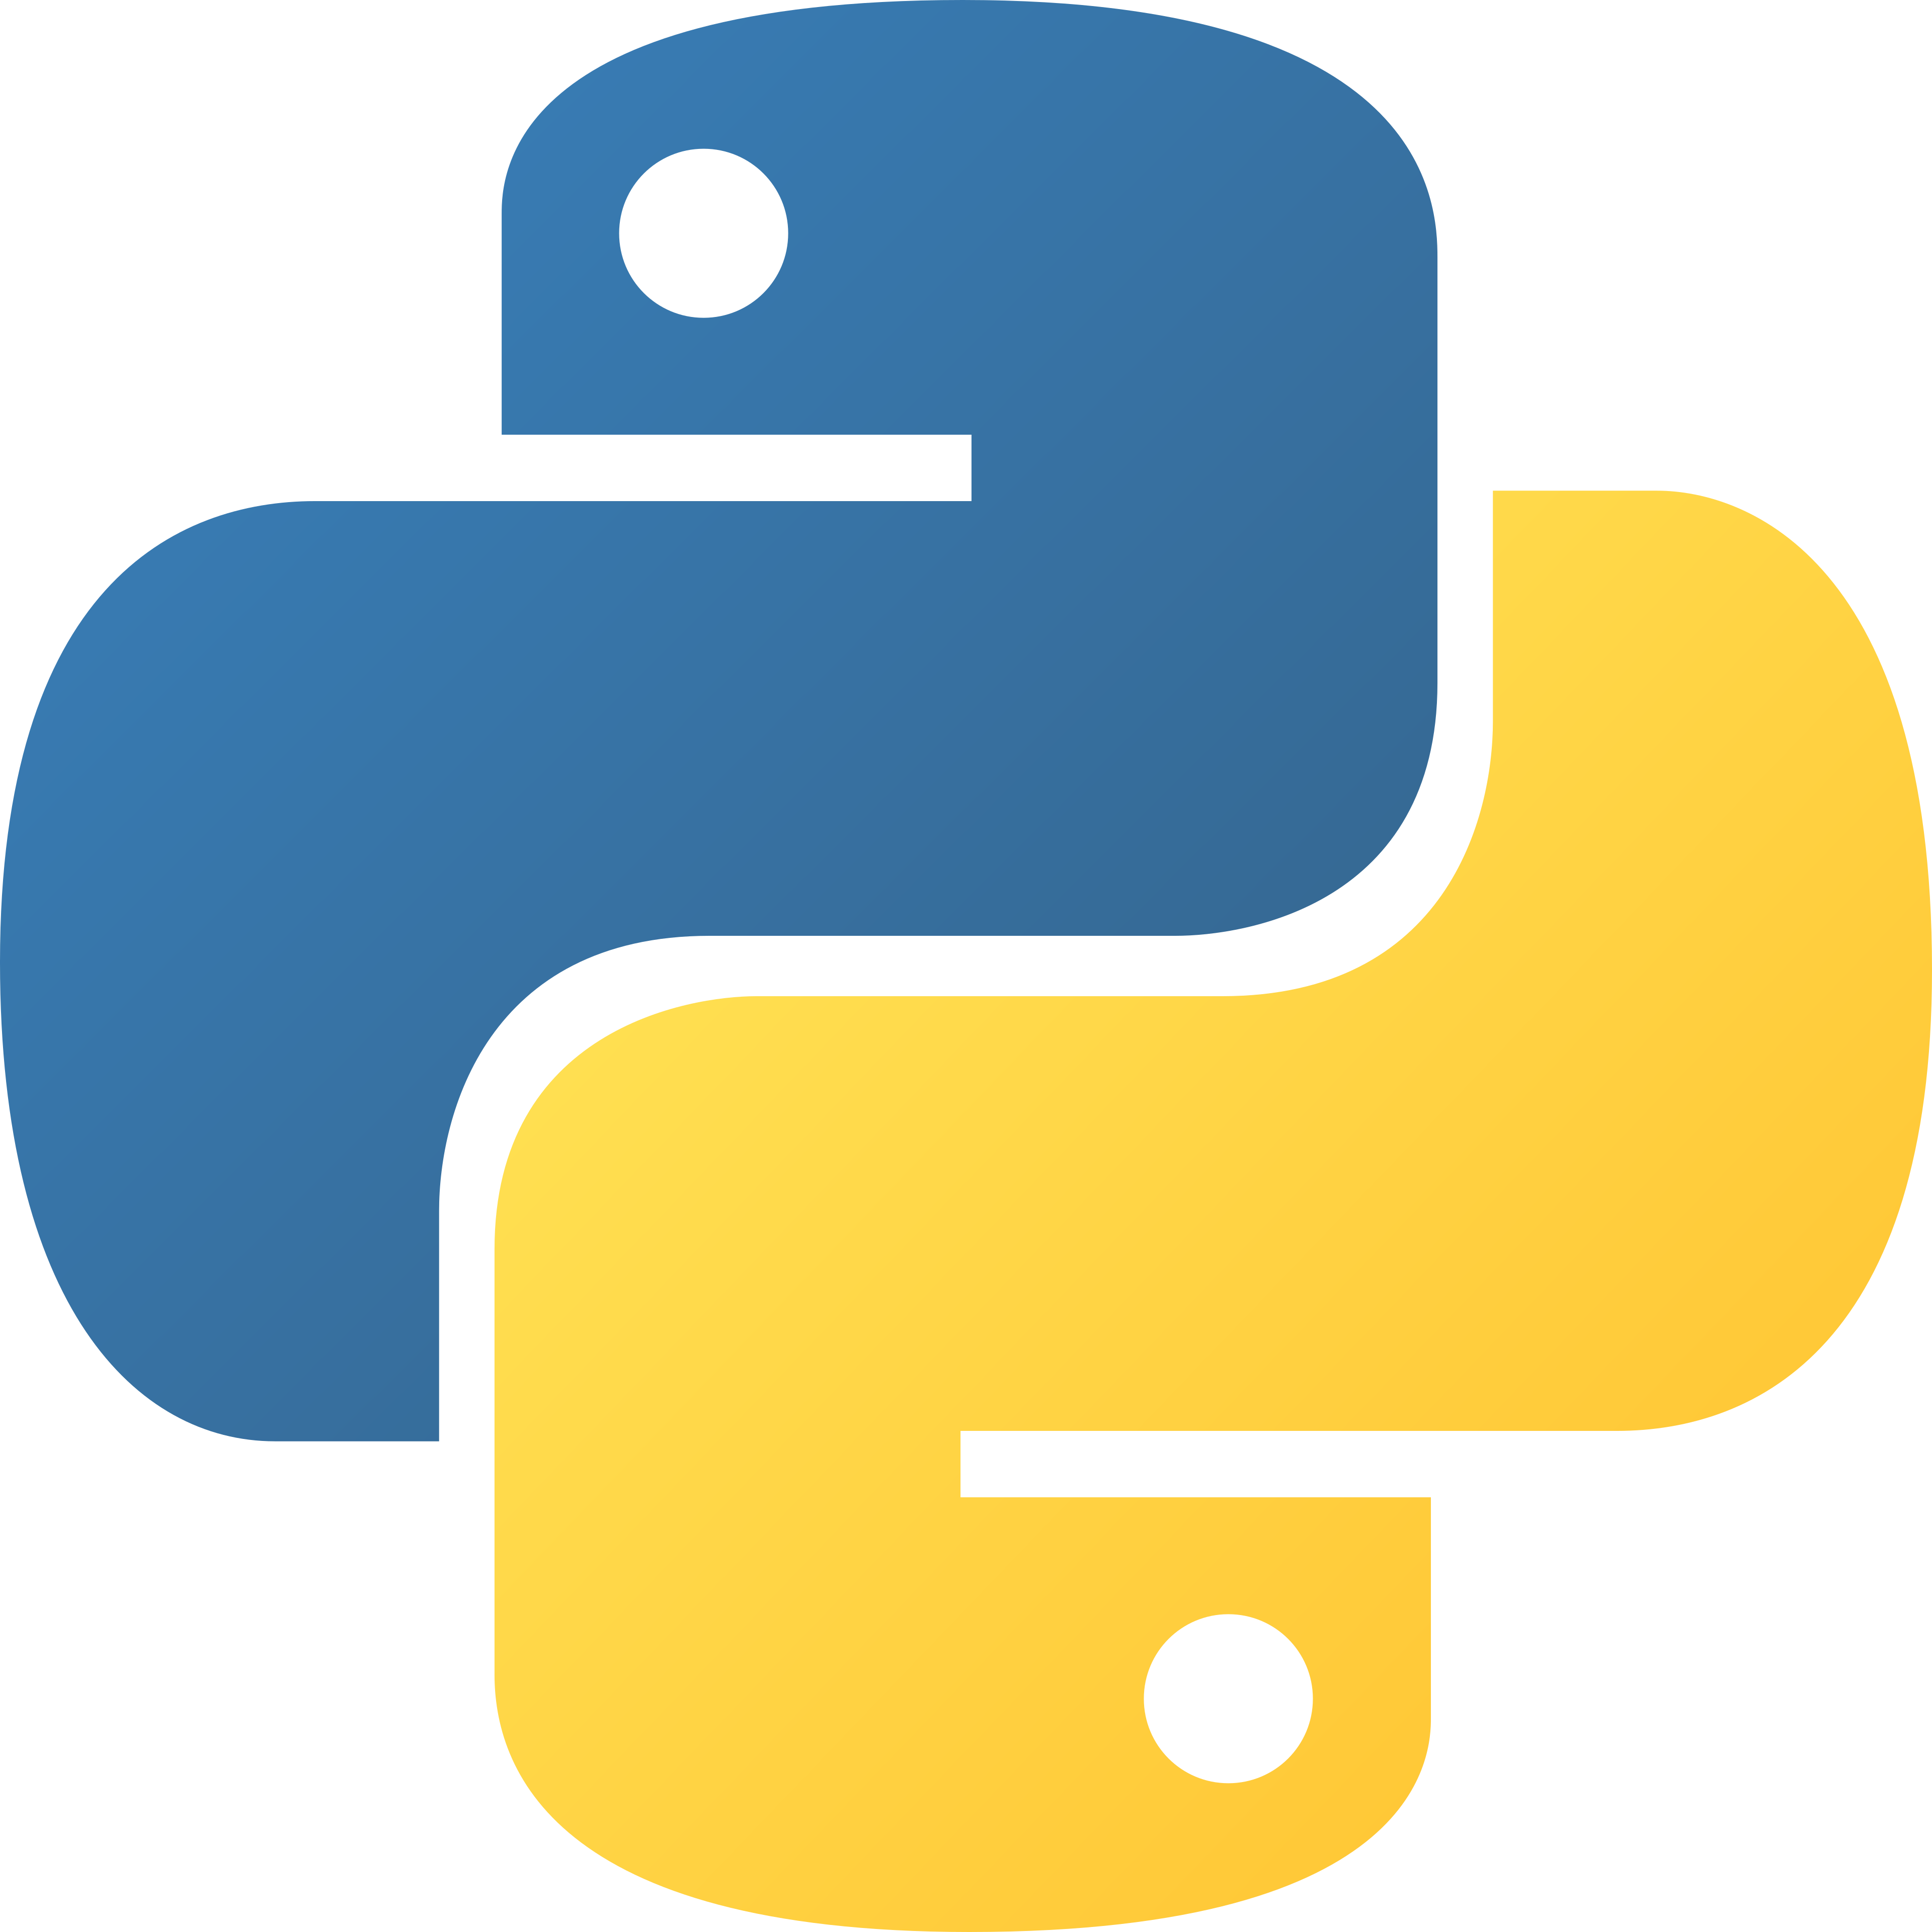
Functions
def greet(name):
print("Hello,", name)
greet("Ali")
greet("Sara")
PYTHON FOR BEGINNERS · DAY 8
Writing your own commands
Instructor: Homaira Mohammadi
Notes:
Welcome! So far we used Python's built-in commands. Today we learn to create our own.

Slide 2

By the end of today, you can…
TODAY’S GOALS
Explain what a function is
Define one with def and call it
Pass in information (parameters)
Use default values
Get a result back with return
Build a calculator with functions 🧮
Python for Beginners · Day 8: functions
2
Notes:
Read the goals together. Functions are how real programs stay organised.

Slide 3
Python’s built-in commands
YOU ALREADY USE FUNCTIONS!
print()
input()
len()
shows output
gets text from the user
counts items
int()
sum()
your_own()
converts to a number
adds up a list
today! 🛠️
Python for Beginners · Day 8: functions
3
Notes:
Every one of these is a function that someone wrote for us. Today students become the ones who write them.

Slide 4
Write once, use many times
WHY FUNCTIONS?
♻️
📖
🔧
🧱
Reuse
Read
Fix
Organise
No copy-pasting the same code
A good name explains the job
Fix a bug in one place
Split big problems into small pieces
A function is like a recipe 📜: write it once, “cook” it whenever you want.
Python for Beginners · Day 8: functions
4
Notes:
A function is a named block of code that does one job. Use the recipe analogy: the recipe is written once in the book, but you can cook it many times.

Slide 5
Your first function
DEFINE, THEN CALL
Code
Output
# 1. define it
def say_hello():
print("Hello!")
print("Welcome 🐍")
# 2. call it
say_hello()
say_hello()
Hello!
Welcome 🐍
Hello!
Welcome 🐍
def + name + () + colon, then indent.
Python for Beginners · Day 8: functions
5
Notes:
Important: defining a function does NOT run it. Nothing happens until we call it. Also, a function must be defined before it is called, because Python reads from top to bottom.

Slide 6
Giving a function information
PARAMETERS
Code
Output
def introduce(name, age):
print(f"I am {name}, {age}.")
introduce("Ali", 20)
introduce("Sara", 19)
I am Ali, 20.
I am Sara, 19.
Parameters = the names in the definition: name, age
Arguments = the values you pass in: "Ali", 20
Python for Beginners · Day 8: functions
6
Notes:
Order matters: the first argument goes into the first parameter. Students can also write introduce(age=20, name="Ali") to be extra clear.

Slide 7
A value to use if none is given
DEFAULT VALUES
Code
Output
def greet(name, greeting="Hello"):
print(f"{greeting}, {name}!")
greet("Ali")
greet("Sara", "Salaam")
Hello, Ali!
Salaam, Sara!
No greeting given → "Hello" is used.
Python for Beginners · Day 8: functions
7
Notes:
You have used a default before without knowing it: print() has end="\n" as a default, which is why each print starts a new line.

Slide 8
Getting a result back
RETURN
Code
Output
def add(a, b):
return a + b
result = add(3, 5)
print(result)
print(add(10, 20) * 2)
8
60
The result can be stored and used in more calculations.
Python for Beginners · Day 8: functions
8
Notes:
return gives a value back to the code that called the function, and stops the function immediately. Think of it as the function handing you its answer.

Slide 9
print shows, return gives back
⚠️ COMMON CONFUSION
def add_print(a, b):
print(a + b)
def add_return(a, b):
return a + b
x = add_print(2, 3)
y = add_return(2, 3)
print(x, y) # None 5
A function without return gives back None (nothing).
Python for Beginners · Day 8: functions
9
Notes:
Run this live. add_print shows 5 on the screen but gives nothing back, so x is None. add_return shows nothing but gives back 5, so y is 5. Usually we want return.

Slide 10
A grade function
🧩 PUT IT TOGETHER
def grade(score):
if score >= 80:
return "A"
elif score >= 50:
return "Pass"
return "Fail"
for s in [95, 62, 30]:
print(s, grade(s))
95 A
62 Pass
30 Fail
Functions + if/elif + loops + lists — all working together.
The notebook builds a full calculator this way.
Python for Beginners · Day 8: functions
10
Notes:
Because return stops the function, we don't need an else at the end. Ask: what does grade(80) return? (A, because 80 >= 80.)

Slide 11
Predict before you run!
🧠 QUICK CHECK
Q1. What is printed?
Q2. Why None?
Q3. What is printed?
def double(x):
return x * 2
print(double(double(3)))
def square(x):
print(x * x)
r = square(4)
print(r)
def hi(n="friend"):
return "Hi " + n
print(hi())
Python for Beginners · Day 8: functions
11
Notes:
Answers: Q1 = 12 (double(3) is 6, double(6) is 12). Q2 = square prints 16 but does not return, so r is None; fix with return x * x. Q3 = Hi friend (the default is used).

Slide 12
What we learned today
SUMMARY
Code | Meaning
def greet(): | define a function
greet() | call (run) it
def greet(name): | a parameter
def greet(name="friend"): | a default value
return a + b | give back a result
no return | the function gives back None
Python for Beginners · Day 8: functions
12
Notes:
Ask students to explain each row in their own words.

Slide 13
Practice time!
⭐ square(n) and birthday wishes
💻 YOUR TURN
⭐⭐ Temperature converter
⭐⭐⭐ Report card 📄
Open exercises.ipynb in the Day 8 folder and solve the 10 tasks, from ⭐ to ⭐⭐⭐.
Next lesson: Dictionaries & tuples 🗂️
Notes:
Give students 20–30 minutes. Encourage good function names that describe the job.

